Slide 1
Environmental concerns with NORM generated by shale gas extraction – Management strategies and health risks
ShaleNetwork Workshop
May 7-8, 2015
Tieyuan Zhang and Radisav Vidic
Civil & Environmental Engineering
University of Pittsburgh, Pittsburgh, PA 15261
Project funded by the US Department of Energy, National Energy Technology Laboratory

Slide 2
Marcellus Shale Wastewater
 | Minimum | Maximum | Average | Number of samples | Source
TDS (mg/L) | 680 | 345,000 | 106,390 | 129 | Barbot et al. 2013
TSS (mg/L) | 4 | 7,600 | 352 | 156
oil and grease (mg/L) | 4.6 | 802 | 74 | 62
COD (mg/L) | 195 | 36,600 | 15,358 | 89
pH | 5.1 | 8.42 | 6.56 | 156
Alkalinity (mg/L as CaCO₃) | 7.5 | 577 | 165 | 144
SO₄ (mg/L) | 0 | 763 | 71 | 113
Cl (mg/L) | 64.2 | 196,000 | 57,447 | 154
Br (mg/L) | 0.2 | 1,990 | 511 | 95
Na (mg/L) | 69.2 | 117,000 | 24,123 | 157
Ca (mg/L) | 37.8 | 41,000 | 7,220 | 159
Mg (mg/L) | 17.3 | 2,550 | 632 | 157
Ba (mg/L) | 0.24 | 13,800 | 2,224 | 159
Sr (mg/L) | 0.59 | 8,460 | 1,695 | 151
Ra-228 (pCi/L) | 300 | 846 | 592 | 14 | Rowan et al. 2011
Ra-226 (pCi/L) | 1,312 | 5,446 | 3,501 | 14
U-235 (pCi/L) | 0 | 20 | 1 | 14 | Barbot et al. 2013
U-238 (pCi/L) | 0 | 497 | 42 | 14
Ra isotopes are the dominant form of NORM in Shale wastewater

Slide 3
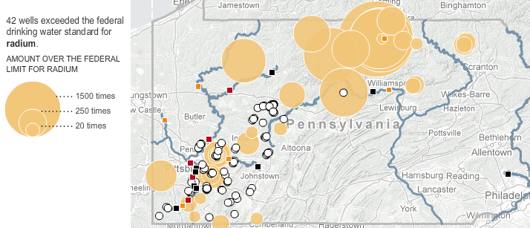
Radium content in FB water across PA
18,045 pCi/L
Citation: NY Times February 26, 2011.
Toxic Contamination From Natural Gas wells
Notes:
Colored cycles are scaled to show the amount of Ra found in waste water from each well.
http://www.nytimes.com/interactive/2011/02/27/us/natural-gas-map.html?ref=us

Slide 4
NORM regulations
Radionuclide Concentration
Gas
[Rn] = 4 pCi/L
Drinking water
[Ra] = 5 pCi/L
[Rn] = 300 pCi/L
Wastewater discharge
[Ra] = 60 pCi/L
Soil
Top: [Ra] = 5pCi/g
Subsurface (> 15cm): [Ra] = 15 pCi/g
Landfills
[Ra] = 5 to 50 pCi/g
(25 pCi/g in PA)
Health Risks (Dose Equivalent)
Quantifies biological effect due to exposure to radioactive material
Unit: Roentgen Equivalent Man (rem)
1 rem exposure carries a 0.055% chance of eventually developing cancer
NRC regulations:
General public:
Annual limit = 100 mrem/yr;
Hourly limit = 2 mrem/hr
Nuclear plant workers:
Unrestricted area = 500 mrem/yr;
Restricted area = 5,000 mrem/yr

Slide 5
Health risks associated with NORM generated from Marcellus Shale gas extraction
Absorbed Dose
(amount of radiation energy received)
Radionuclide type, concentration, geometry,
time
Exposure pathway (external exposure; inhalation; digest etc.)
NORM Concentration
Dose Equivalent
(Health Effect caused by the radiation energy)

Slide 6

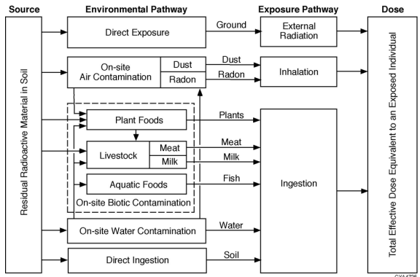
Estimation of radiation exposure
Radionuclides ➔ Environmental Pathways ➔ Exposure dose rate
Notes:
In order to calculate Exposure dose rate, one need to consider all the pathways that might carries out radiation to human being. Inhalation & Radon inhalation, ingestion, External gamma exposure should be considered.

Slide 7
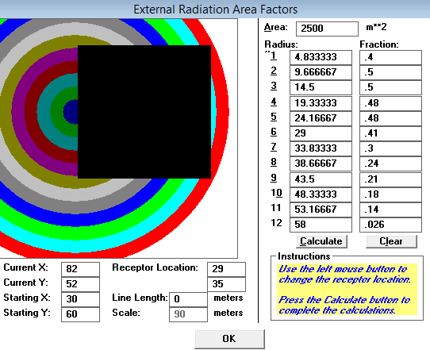
Case study 1: Radiation Dose Equivalent in Flowback Impoundment
Key Assumptions for Total Effective Dose Equivalent (TEDE) Calculation
Geometry of Contaminated area
Flowback water impoundment
Pathways | External Gamma, Inhalation, Soil Ingestion, Radon
Contaminated Zone | 100m(L)×50m(W)×4m(H) impoundment
Radionuclide Concentration | Ra²²⁶=2,500 pCi/L; Ra²²⁸=250 pCi/L; U-238=10 pCi/L; Th-232=1 pCi/L
Amount of contaminated material | 5.28 million gallons of flowback water (i.e., 13.2 mCi of Ra²²⁶)
Radon emanation ratio | 1.0
Outdoor time fraction | 12.5% (3 hr/day working closely with radioactive material)
Inhalation rate | 11,400 m³/yr
Soil ingestion | 36.5 g/yr²
Notes:
http://blogs.agu.org/wildwildscience/2009/09/01/how-much-radiation-does-it-take-to-kill-you/
Average american: receive ~ 150 – 300 mrem per year.
National Academies:
100 mrem/year over a lifetime ➔ cause one cancer in every 175 people.
Get a sudden dose of 350 rem of radiation ➔ 50% chance to die in 60 days;
Get a sudden dose of 1000 rem of radiation ➔ die in 1 hour.

Slide 8
Case study 1: Total Effective Dose Equivalent (TEDE) in Flowback Impoundment
Radionuclide | Pathways |  |  |  | Total Dose Equivalent (mrem/yr) | Risks
 | External Gamma (mrem/yr) | Radon inhalation (mrem/yr) | Inhalation (mrem/yr) | Soil (mrem/yr)
Ra-226 | 4.78 | 1.01E-02 | 5.36E-03 | 3.49E-02 | 4.827 | 1.23E-04
Ra-228 | 0.281 | 3.22E-03 | 1.21E-03 | 7.64E-03 | 0.293 | 6.04E-06
Th-232 | 6.41E-05 | 5.39E-07 | 2.47E-05 | 1.23E-05 | 1.02E-04 | 6.06E-08
U-238 | 2.98E-04 | 1.90E-20 | 1.78E-05 | 2.16E-05 | 3.37E-04 | 7.16E-09
Total | 5.06E+00 | 1.34E-02 | 6.61E-03 | 4.26E-02 | 5.121 | 1.29E-04
The external gamma radiation is the dominane pathway and contribute more than 98% of TEDE
The TEDE of 5.121 mrem/yr is well below the NRC limit for general public (100 mrem/yr)

Slide 9
Case study 1: Sensitivity Analysis
The indoor exposure and the location of the recipient had the greatest impact
Notes:
Increase the distance;
Decrease the radiation energy received by recipient;
Decrease the Dose Equivalent.

Slide 10
Case study 2: Radiation Dose Equivalent in Centralized Waste Treatment Facility
Key Assumptions for Total Effective Dose Equivalent (TEDE) Calculation
Centralized Waste Treatment Facility
Pathways | External Gamma, Inhalation, Soil Ingestion, Radon
Treatment plant capacity | 100,000 gal/day
Flowback water quality | Ba=687 mg/L; Ra²²⁶=1,000 pCi/L; Ra²²⁸=100 pCi/L
Contaminated Zone | 2m(L)×2m(W)×0.83m(H) (Radioactive solid waste stored in a tank)
Ra Conc. In solid | Ra²²⁶=4,286 pCi/g; Ra²²⁸=428 pCi/g (Based on the complete Co-precipitation of Ra-BaSO₄)
Amount of contaminated material | 13.2 tons of solid (i.e., 11.4 mCi of Ra²²⁶)
Radon emanation ratio | 0.22
Outdoor time fraction | 12.5% (3 hr/day working closely with radioactive material)
Inhalation rate | 11,400 m³/yr
Soil ingestion | 36.5 g/yr²
Notes:
*: solid waste generated from sulfate precipitation during 30 days of operation for a 100,000 gallon/day treatment facility;
**: Calculated based on the complete co-precipitation of Ra-SO4, while Ra226=1000pCi/L, Ra228=100 pCi/L; Ba=687 mg/L;
Barite density=4g/cm³;

Slide 11
Case study 2: Total Effective Dose Equivalent (TEDE) in Centralized Waste Treatment Facility
Radionuclide | Pathways |  |  |  | Total Dose Equivalent (mrem/yr) | Risks
 | External Gamma (mrem/yr) | Radon inhalation (mrem/yr) | Inhalation (mrem/yr) | Soil (mrem/yr)
Ra-226 | 968 | 1.29E-4 | 1.62 | 9.01E-2 | 970 | 2.25E-02
Ra-228 | 57.3 | 9.29E-5 | 0.37 | 1.97E-2 | 57.7 | 7.79E-04
Total | 1,030 | 1.21E-4 | 1.99 | 1.10E-1 | 1030 | 2.33E-02
The TEDE in the centralized waste treatment facility may be significantly above the NRC limit for general public (100 mrem/yr).

Slide 12
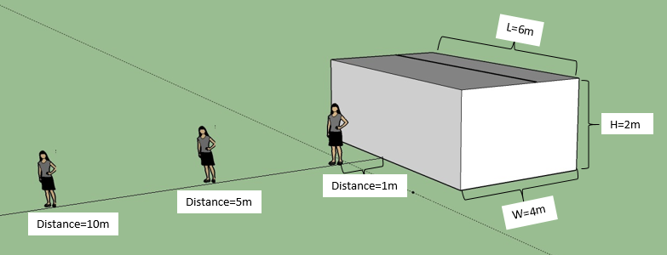
Case study 2: Sensitivity Analysis
The location of recipient (i.e. on-site worker) has the greatest impact on TEDE contributed by external gamma radiation
The geometry of contaminated zone and varying recipient location
Correlation between the distance of recipient to waste and TEDE
A safe distance of 3 – 5 m between recipient and radioactive solids is recommended.

Slide 13
Case study 3: Radiation Dose Equivalent in Landfill
Key Assumptions for Total Effective Dose Equivalent (TEDE) Calculation
Landfill
Pathways | External Gamma, Inhalation, Soil Ingestion, Radon
Contaminated Zone | 100m(L)×100m(W)×1m(H)
Soil Concentration | Ra²²⁶=5 pCi/g; Ra²²⁸=0.5 pCi/g
Soil density | 1.5 g/cm³
Amount of contaminated material | 15,000 tons (i.e., 75 mCi of Ra²²⁶)
Radon emanation ratio | 0.22
Indoor time fraction | 17% (4 hr/day)
Outdoor time fraction | 12.5% (3 hr/day)
Inhalation rate | 11,400 m³/yr
Soil ingestion | 36.5 g/yr²
Notes:
Sketch；

Slide 14
Case study 3: Total Effective Dose Equivalent (TEDE) in Landfill
Radionuclide | Pathways |  |  |  | Total Dose Equivalent (mrem/yr) | Risks
 | External Gamma (mrem/yr) | Radon inhalation (mrem/yr) | Inhalation (mrem/yr) | Soil (mrem/yr)
Ra-226 | 12 | 40.2 | 6.67E-3 | 6.18E-2 | 52.2 | 2.03E-3
Ra-228 | 0.70 | 0.02 | 1.50E-3 | 1.35E-2 | 0.73 | 1.11E-5
Total | 12.6 | 40.2 | 8.17E-3 | 6.53E-2 | 52.8 | 2.04E-3
TEDE is mainly contributed by the inhalation of Radon gas
TEDE in the landfill scenario is below the NRC limit for general public

Slide 15
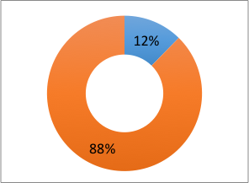
Case study 3: Sensitivity Analysis
1. Indoor Versus Outdoor Exposure
2. Depth of Cover Layer
Outdoor Dose
Equivalent
Indoor Dose
Equivalent
TEDE contributed by indoor and outdoor exposure
Correlation between the distance of recipient to waste and TEDE
Radiation exposure is mainly contributed by the indoor inhalation of Rn gas
Placement of a cover layer could significantly decrease the TEDE

Slide 16
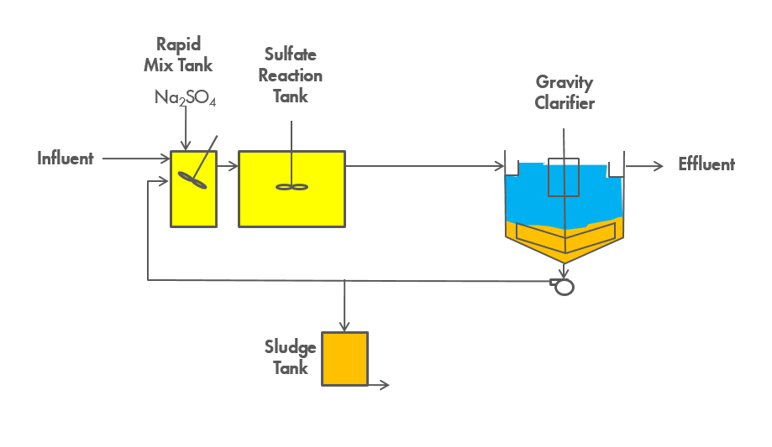
TENORM Waste
Regional and mobile treatment facilities use sulfate and carbonate precipitation to adjust the chemistry of flowback water for reuse in hydraulic fracturing.

Slide 17
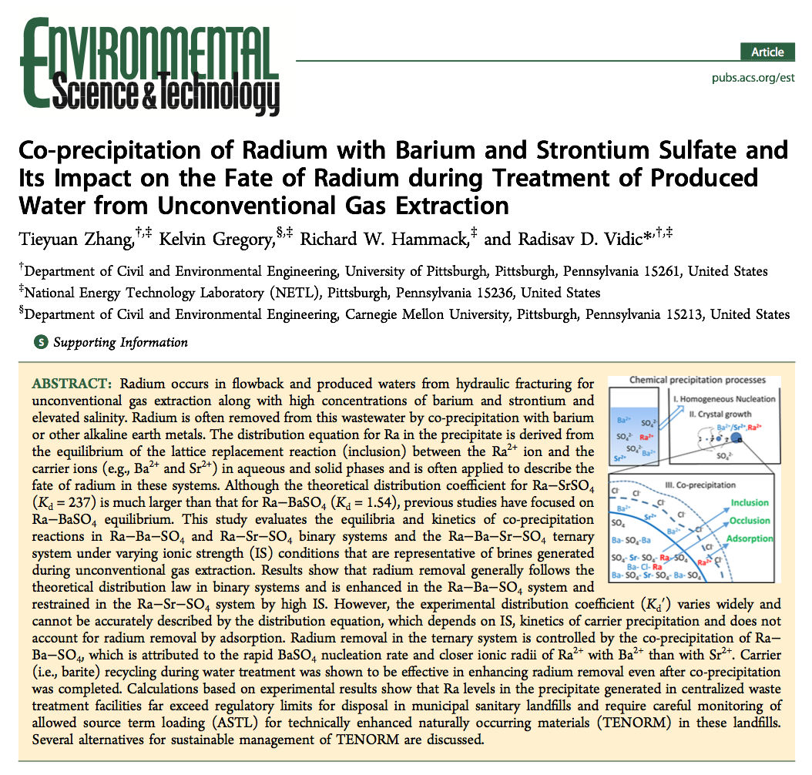
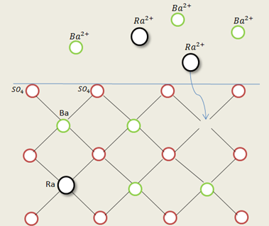
Ra removal during sulfate precipitation
M²⁺ + SO₄²⁻ → MSO₄ (Precipitation)
Ra²⁺ + MSO₄ → M²⁺ + RaSO₄ (Lattice Replacement)
Inclusion
Occlusion
Equilibrium Constant:
Define Distribution Coefficient:
Then，
Mechanism of Co-Precipitation
For Ra-BaSO₄ co-precipitation, Kd=1.54.
Experimental results show Kd ranging from 1.07 – 7.49.

Slide 18
Ra in solid waste generated by CWT facility
Ra content is significantly higher than the landfill disposal limit of 25 pCi/g
Theoretical calculation of Radium concentration in solution and solid waste generated by sulfate precipitation
[Ra²⁺]₀ = 5,400 pCi/L, [Ba²⁺]₀ = 2,200 mg/L.

Slide 19
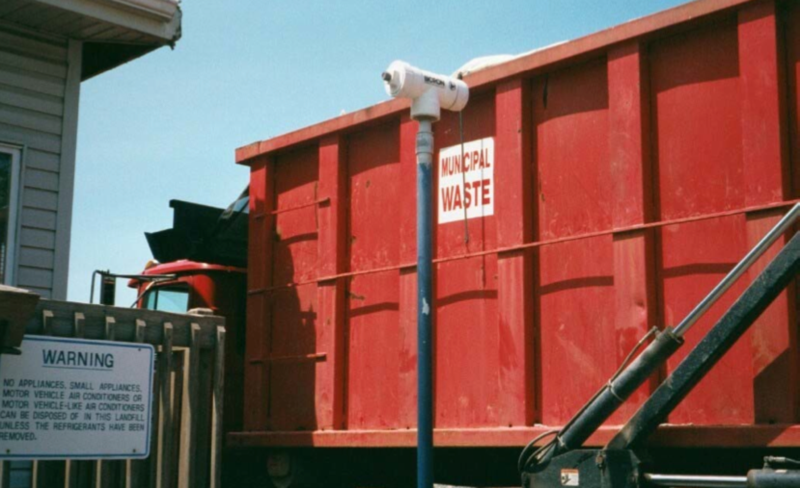
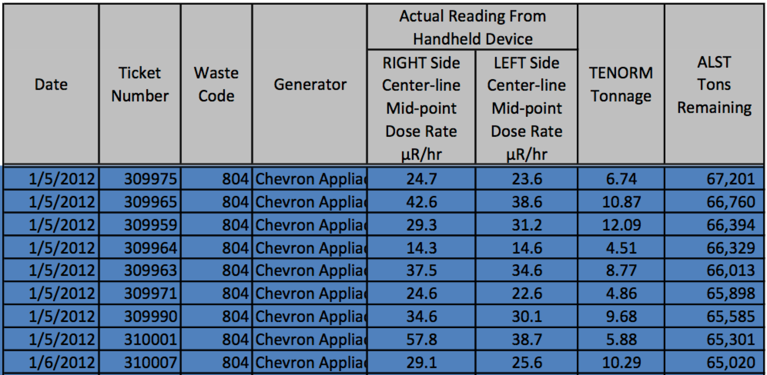
Disposal of TENORM waste in landfills
Assessment of radioactive material input
Tracking the Allowed Source Term Loading (ALST)
The NORM is tracked by recording the tonnage of radioactive material accepted by the landfill
Solid waste associated with Marcellus gas extraction containing extremely high Ra concentration can be mixed with other solid waste to fulfill the overall NORM limit in landfill

Slide 20
NORM Loading in PA Landfills
Total Ra generation rate with produced water:
There are 7,500 active Marcellus Shale wells in PA in 2014
Each well produces 10 bbl/day of produced water containing 5,000 pCi/L of Ra-226
Total Ra-226 = 22 Ci.
Total Capacity of PA municipal landfills is ~5 million tons/yr;
22 x 10¹² pCi
5 x 10⁶ t x 10⁶ g/t
[Ra-226] = ---------------------------- = 4.4 pCi/g
Ra-226 loading from current Marcellus wells is close to surface cleanup standard (5 pCi/g), but is still below the subsurface cleanup standard (15 pCi/g) and landfill limit in PA (25 pCi/g).
Notes:
Injection is not an option;
Ra would be eventually end up in solids,

Slide 21
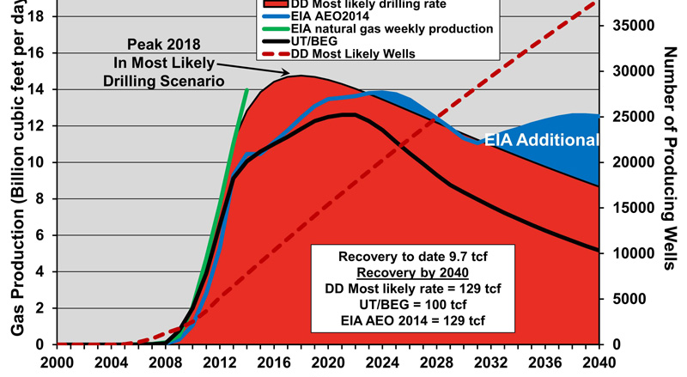
Average Ra conc. in PA landfill would exceed limit (25 pCi/g) by late 2030s
Citation: Fracking Fracas: The Trouble with Optimistic Shale Gas Projections by the U.S. Department of Energy, 2014.

Slide 22
Summary and Conclusions
NORM generated by gas extraction from Marcellus Shale
Ra is the dominant form of NORM in Marcellus Shale wastewater and its conc. is more than thousand times above the drinking water limit (5 pCi/L);
Co-precipitation of Ra with BaSO₄ is effective in removing Ra from Marcellus Shale produced water; TENORM waste activity ranges from hundreds to more than 10,000 pCi/g.
TENORM waste can be mixed with other solid waste to fulfill the overall NORM limit in a landfill; total landfill capacity will be exceed in late 2030s even if all waste is uniformly distributed in PA landfills.

Slide 23
Summary and Conclusions
Health risks associated with NORM
External gamma radiation and inhalation of radon gas are the dominant pathway that contributes to the total effective does equivalent.
TEDE for baseline conditions at storage impoundments, centralized waste treatment facilities, and landfills are 5, 1,030 and 53 mrem/yr, respectively, while the NRC limit for general public is 100 mrem/yr;
A safe distance of 3-5 m is recommended to control TEDE in centralized waste treatment facilities at an acceptable level (14 mrem/yr);

Slide 24

Thank you for your attention
This work was performed as part of the National Energy Technology Laboratory’s Regional University Alliance (NETL-RUA) under the RUA contract RES1000027 156

